Slide 1
Presentation of Simple Game vaultofcodes
Final task :Tic-Tac-Toe

Slide 2
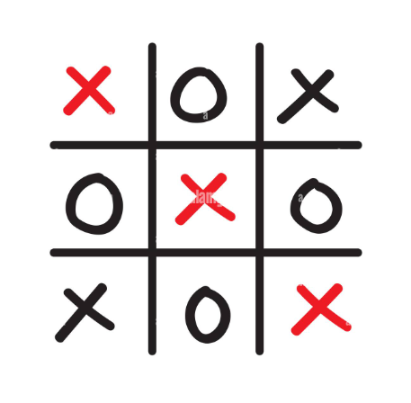
CONTENTS :
1) PROGRAM OF TIC-TAC-TOE
2) OUTPUT OF TIC-TAC-TOE
3) INTRODUCTION
4) WORKING
5) USES
6) ADVANTAGES AND DISADVANTAGES
7) FUTURE SCOPE

Slide 3
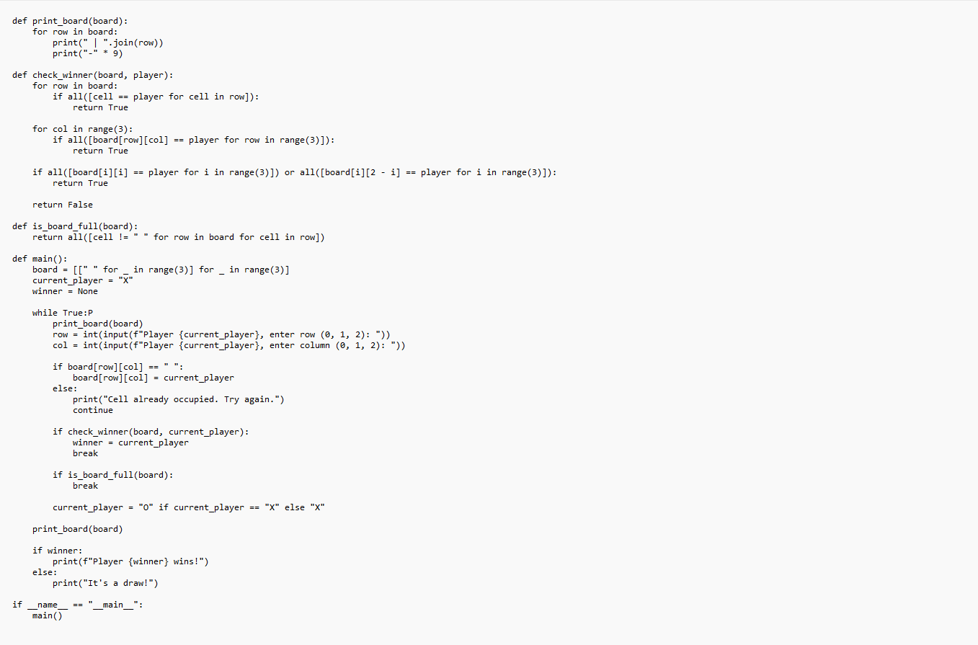
1) PROGRAM OF TIC-TAC-TOE : :

Slide 4
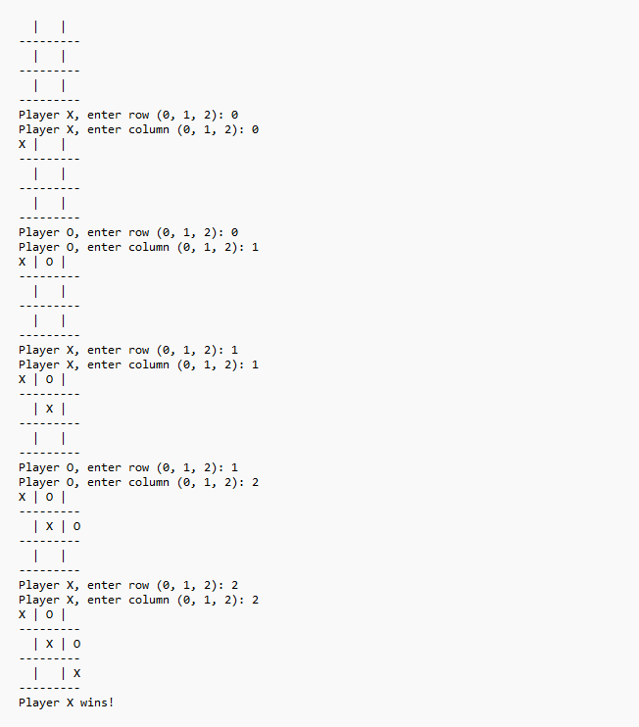
2) OUTPUT OF TIC-TAC-TOE

Slide 5
3) INTRODUCTION :
Tic-Tac-Toe, also known as "Noughts and Crosses" in some parts of the world, is a classic two-player strategy game played on a 3x3 grid. The game's objective is simple: to be the first player to form a straight line of three of their own symbols, either horizontally, vertically, or diagonally, on the grid. Typically, one player uses "X" as their symbol, while the other uses "O," and they take turns placing their symbols on the grid.
The game is easy to learn and provides an entertaining and quick diversion. Despite its simplicity, Tic-Tac-Toe can be surprisingly strategic when played by skilled competitors, making it a popular choice for casual games, especially among children and those looking for a simple yet engaging way to pass the time.
Here are the basic rules of Tic-Tac-Toe:
1. The game is played on a 3x3 grid, resulting in a total of 9 squares.
2. Players take turns, starting with one player who places their symbol (X or O) on an empty square on the grid.
3. The game continues with players taking alternate turns, each attempting to form a row of three of their symbols.
4. The game ends when one player successfully forms a row of three symbols, and that player is declared the winner. The game also ends in a draw (a "cat's game") if all squares on the grid are filled, and no player has formed a winning line
Tic-Tac-Toe is often used as a teaching tool for basic concepts in game theory and AI development, as its simple nature makes it an excellent starting point for understanding strategic decision-making and designing algorithms for game-playing. It serves as the foundation for more complex games like Connect Four and chess.

Slide 6
4) WORKING :
Tic-Tac-Toe is a simple yet engaging two-player strategy game played on a 3x3 grid. In this classic game, two players typically use the symbols "X" and "O" and take turns to place their symbols on the grid. The objective is to form a straight line of three of their own symbols either horizontally, vertically, or diagonally. The game starts with an empty grid, and players alternate turns, aiming to create a winning pattern. The game can end in one of two ways: a player successfully forms a winning line and is declared the winner, or all the squares on the grid are filled, resulting in a draw, also known as a "cat's game." Tic-Tac-Toe is not only a fun pastime but also a valuable tool for teaching basic game theory concepts and for developing algorithms for game-playing due to its simplicity and strategic depth. It serves as the foundation for more complex strategy games, making it a popular choice for players of all age

Slide 7
5) USES :
1. Recreation : Tic-Tac-Toe is a popular recreational game that provides entertainment and fun for people of all ages.
2. Educational Tool : It is frequently employed as an educational tool to teach basic concepts such as pattern recognition, strategy, and decision-making skills, making it an ideal choice for introducing these concepts to children and beginners.
3. Game Theory Introduction : Tic-Tac-Toe serves as an accessible introduction to the principles of game theory, helping individuals understand the fundamental concepts of decision-making, strategy, and optimal moves in competitive situations.
4. Algorithm Development : It is a common starting point for developing and testing algorithms related to game-playing and artificial intelligence, allowing developers to experiment with different strategies and tactics in a manageable environment.
5. Cognitive Skills Improvement : Tic-Tac-Toe can be used as a tool to enhance cognitive skills, including spatial reasoning, logical thinking, and decision-making, making it a valuable exercise for mental development.

Slide 8
6) ADVANTAGES AND DISADVANTAGES :
Advantages:
1. Simplicity
2. Quick
3. Accessible
4. Teaching
5. Entertaining
Disadvantages:
1. Predictable
2. Limited
3. Draws
4. Basic
5. Repetitive

Slide 9
7) FUTURE SCOPE :
1. Enhanced AI and Machine Learning : Further development of AI algorithms for Tic-Tac-Toe can provide more challenging opponents and promote the study of advanced game-playing strategies.
2. Digital and Augmented Reality : Integration into digital platforms and augmented reality applications can enhance the gaming experience and accessibility for modern audiences.
3. Multiplayer and Online Variants : The game can evolve with the inclusion of multiplayer and online features, fostering global competition and social engagement.
4. Educational Applications : Tic-Tac-Toe can continue to be a valuable educational tool, aiding in the teaching of game theory, AI, and basic problem-solving concepts.
5. Research and Development : Tic-Tac-Toe's simplicity can serve as a foundation for more complex games, leading to innovations in game design and AI technology.

Slide 10
THANK YOU
by Bhargava Reddy
Email : yvsbreddy2003@gmail.com

